Slide 1
Introduction to Programming in Python
Exception Handling

Slide 2
What is Exception?
How to handle Exception?
Common built in exception handling
Custom Exception handling

Slide 3
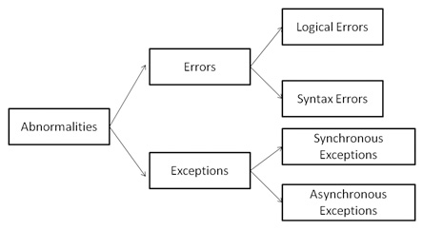
What is Exception handling in python?
A Python program terminates as soon as it encounters an error. In Python, an error can be a syntax error or an exception.
When an error occurs, or exception as we call it, Python will normally stop and generate an error message.

Slide 4
Cont.
Errors are the problems in a program due to which the program will stop the execution.
Exceptions are raised when some internal events occur which changes the normal flow of the program.
Example of syntax error:
a = 12
if a >10
print(a) # missed :, it is an error
Example exception error:
a = 12
b = 0
print(a/b) #dividing by 0 is impossible , it is Exception

Slide 5
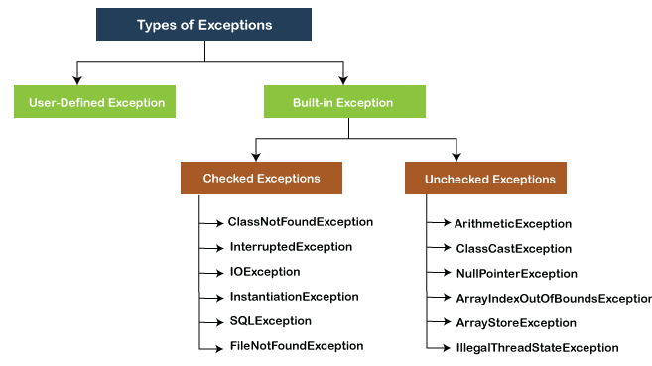
Types of Exceptions

Slide 6
Common built in exception
ZeroDivisionError: when the divisor of a number is zero.
IndexError: When the wrong index of a list is retrieved.
AssertionError: It occurs when the assert statement fails
AttributeError: It occurs when an attribute assignment is failed.
ImportError: It occurs when an imported module is not found.
KeyError: It occurs when the key of the dictionary is not found.
NameError: It occurs when the variable is not defined.
MemoryError: It occurs when a program runs out of memory.
TypeError: It occurs when a function and operation are applied in an incorrect

Slide 7
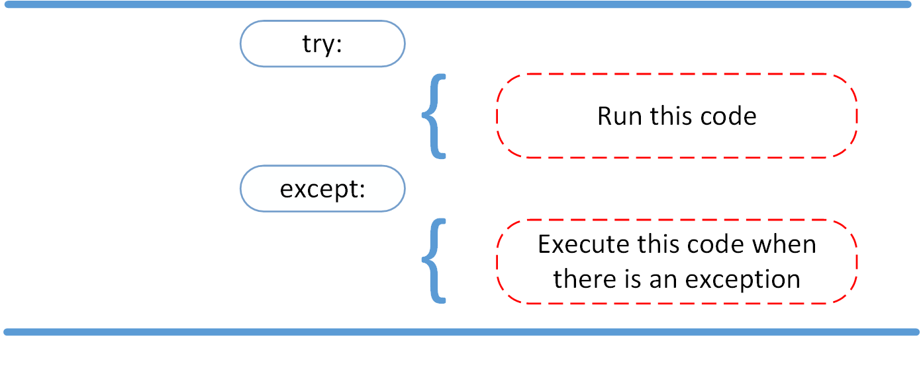
How to handle exception in python?

Slide 8
Cont..
Exception handling include:
First, the try clause (the statement(s) between the try and except keywords) is executed.
If no exception occurs, the except clause is skipped and execution of the try statement is finished.
If an exception occurs during execution of the try clause, the rest of the clause is skipped.

Slide 9
Cont.
a = 12
b = 0
try:
print(a/b)
except:
print(“ There is an error”)

Slide 10
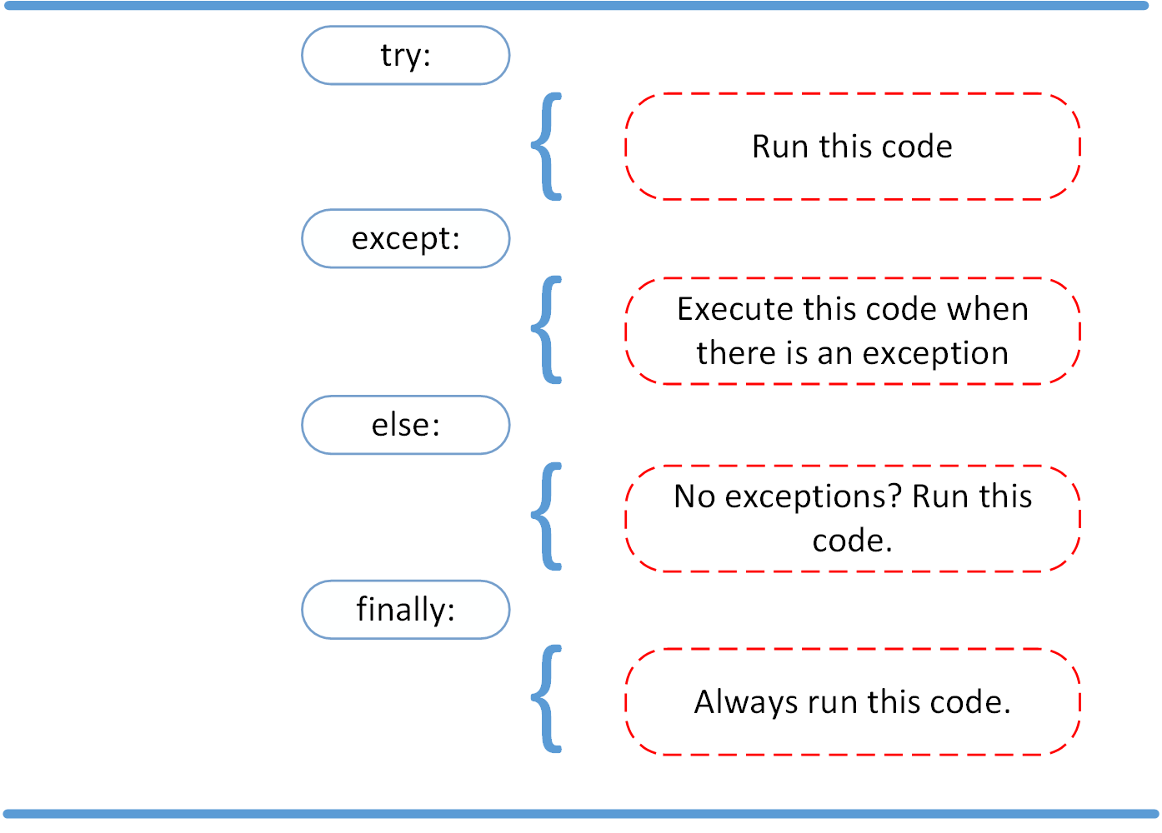
Cont..

Slide 11
User defined Exception in python
User-defined exceptions are also referred to as custom exceptions.
The exceptions created per our use case and thrown using the raise keyword are user-defined exceptions, and such exceptions are derived classes of the Exception class from the python.
a = -10
if a > 0:
raise (“ It is negative number.”)

Slide 12
https://realpython.com/courses/raising-handling-exceptions/

